Slide 1
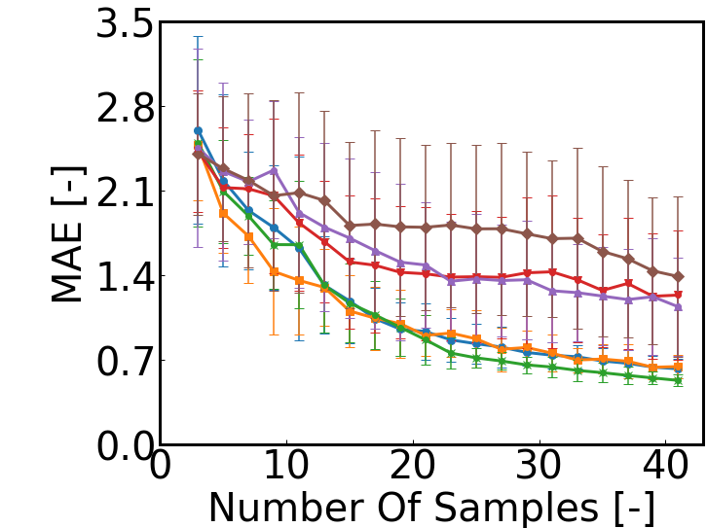
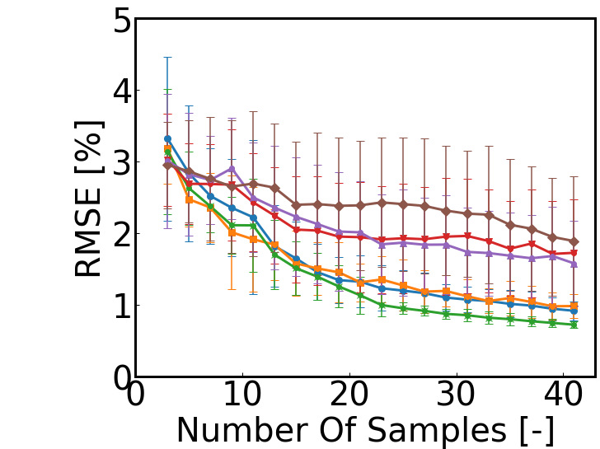
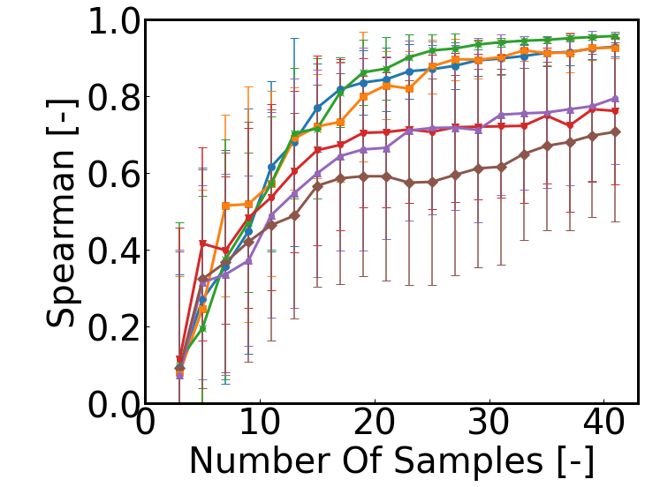
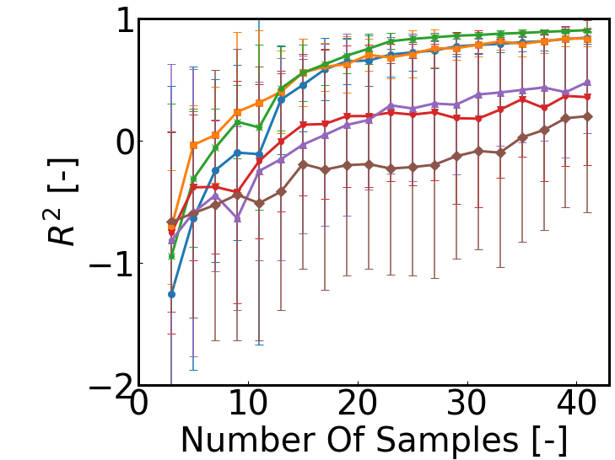
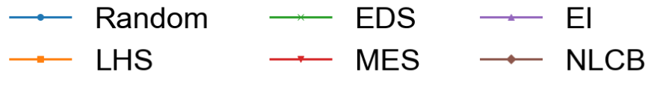
Figure S1
二维函数下不同策略-模型指标折线

Slide 2

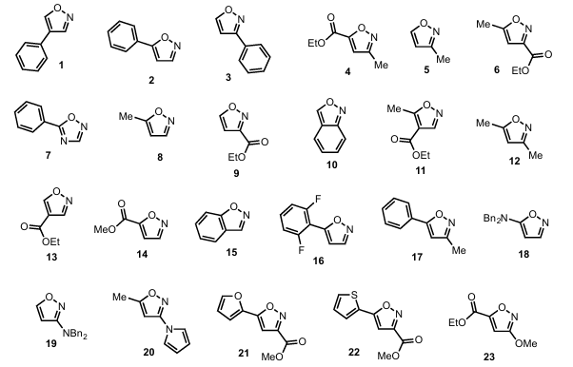
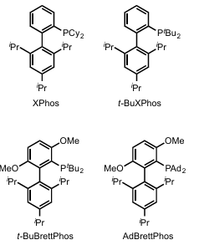
Figure S2
Bases (3)
Pd catalysts (4)
Additives (23)
钯催化分子展示

Slide 3
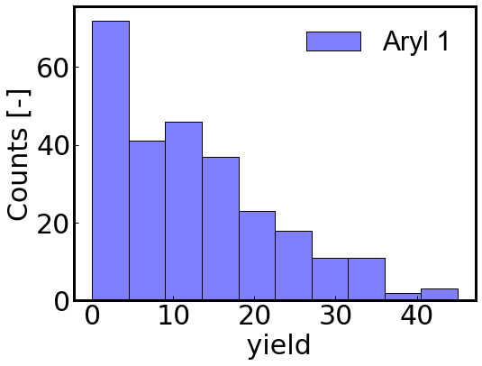
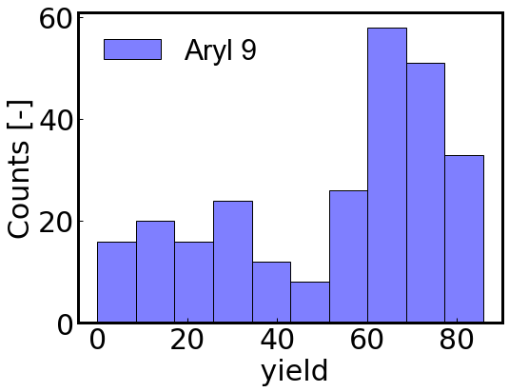
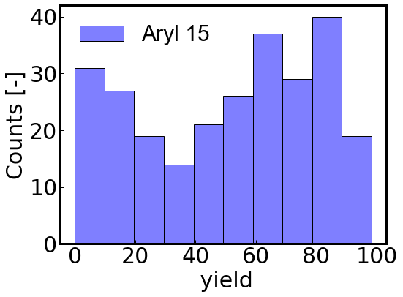
Figure S3
钯催化目标任务-分布直方图

Slide 4
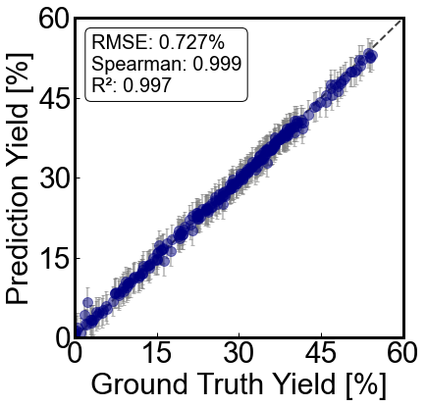
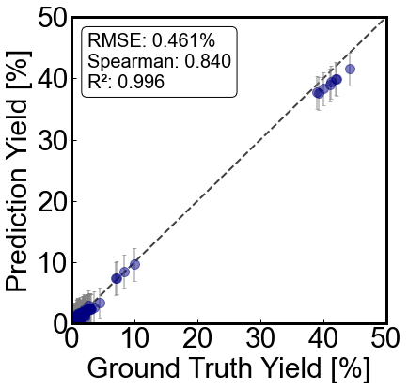
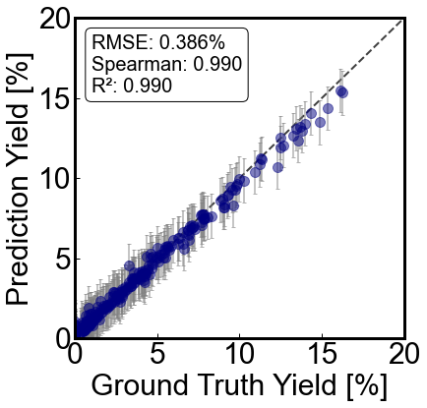
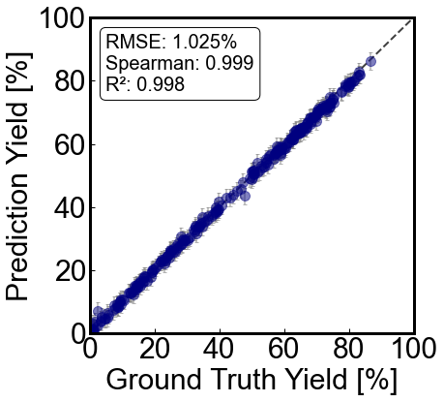
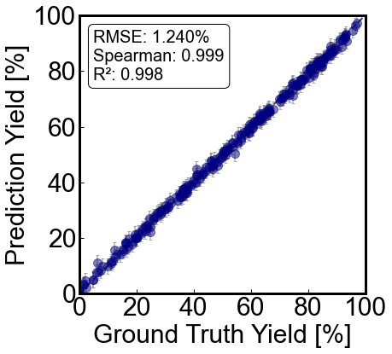
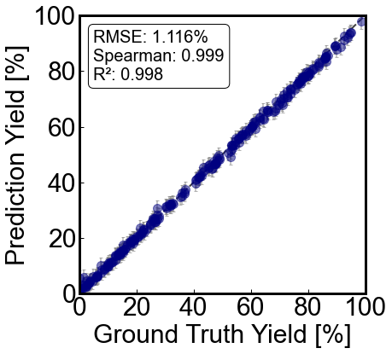
Figure S4
Aryl 2
Aryl 4
Aryl 7
Aryl 8
Aryl 11
Aryl 14
钯催化源模型指标

Slide 5
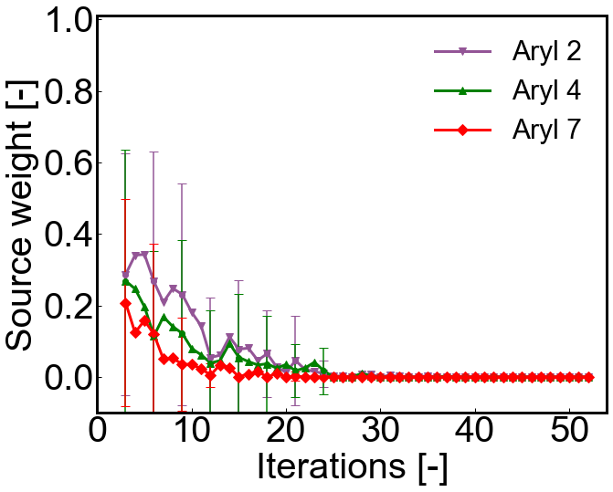
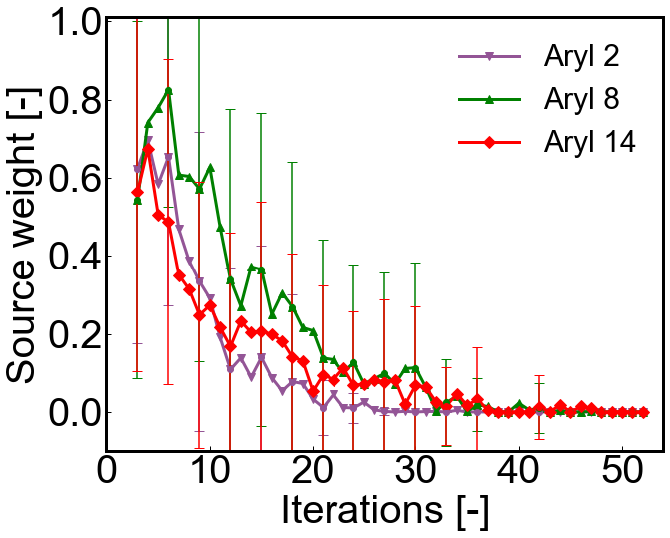
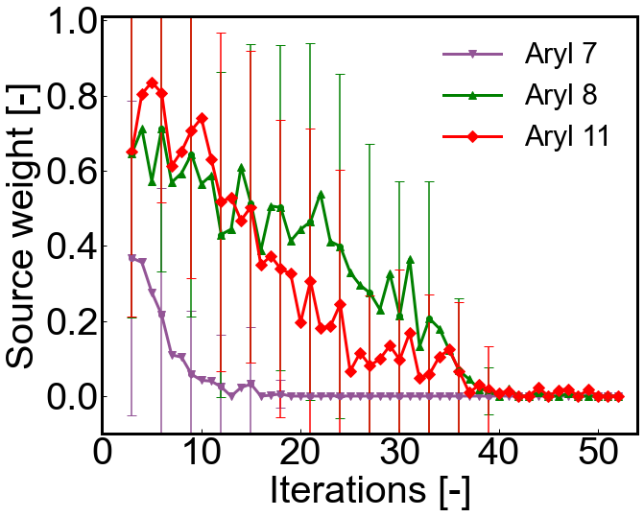
Figure S5
Aryl 1
Aryl 9
Aryl 15
钯催化迁移优化权重折线

Slide 6
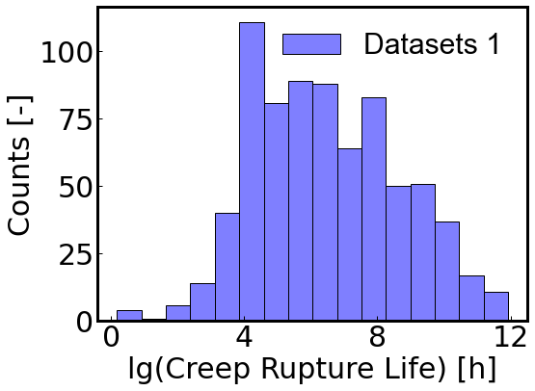
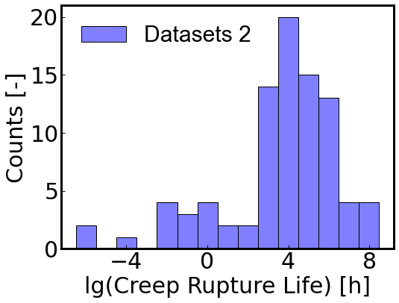
Figure S6
合金数据集目标y-分布

Slide 7
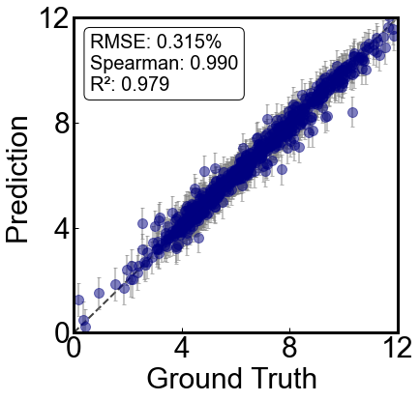
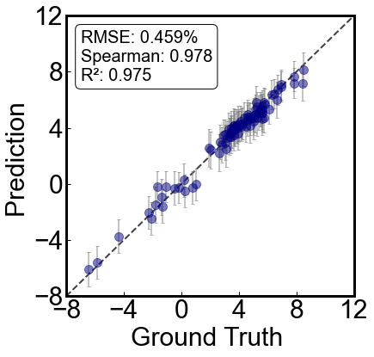
Figure S7
Source model 1
Source model 2
合金数据集-源模型

Slide 8
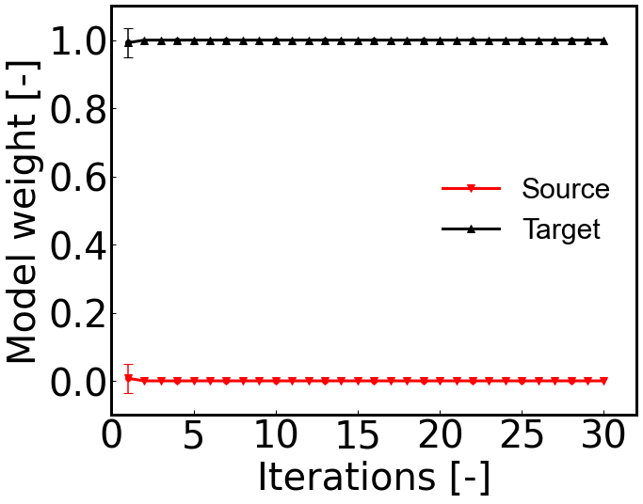
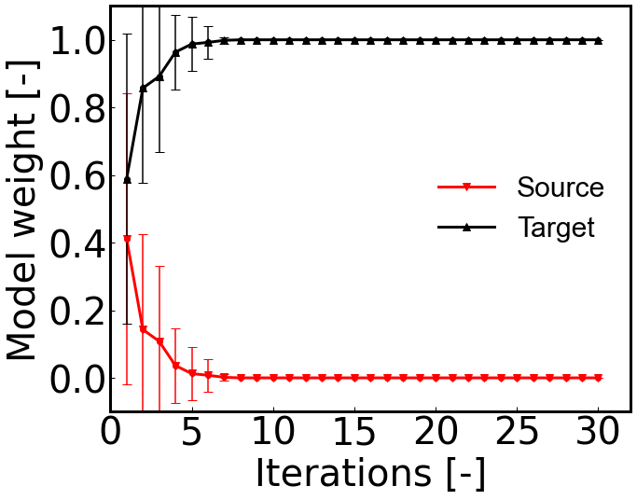
Figure S8
Optimization task 1
Optimization task 2
合金权重折线

Slide 9
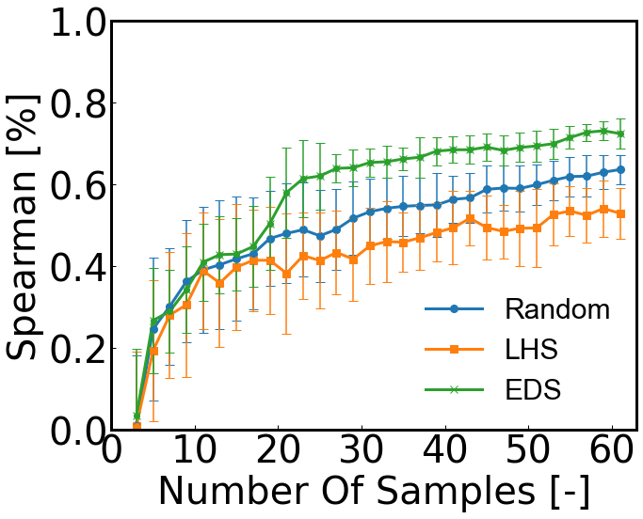
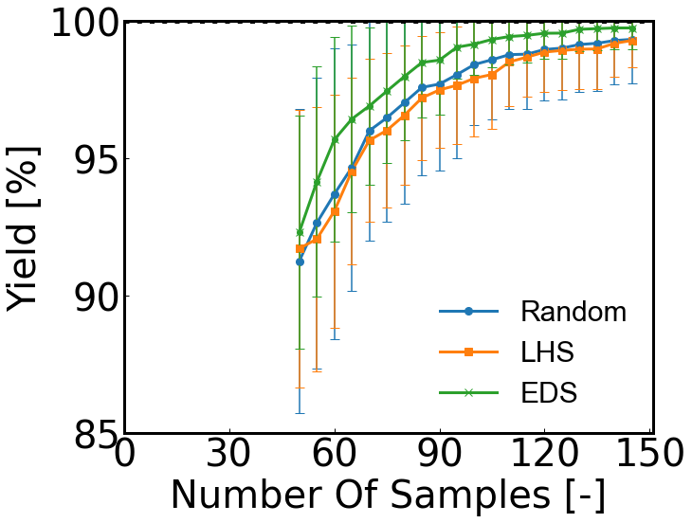
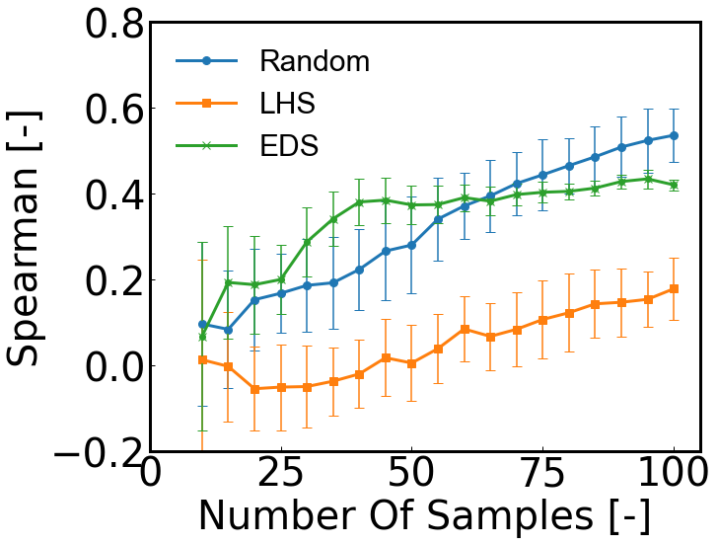
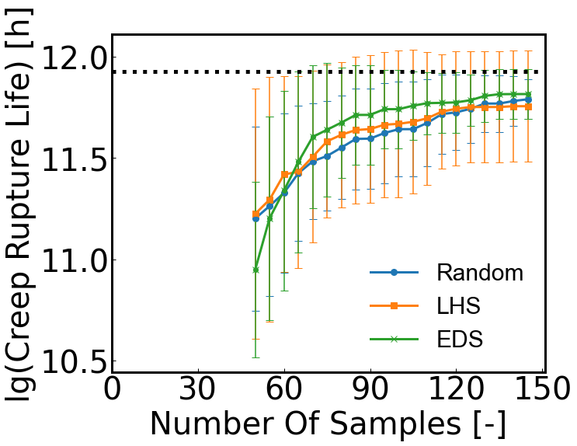
Figure S9
Aryl optimization task
Alloy optimization task
整个数据集上的初始采样测试

Slide 10
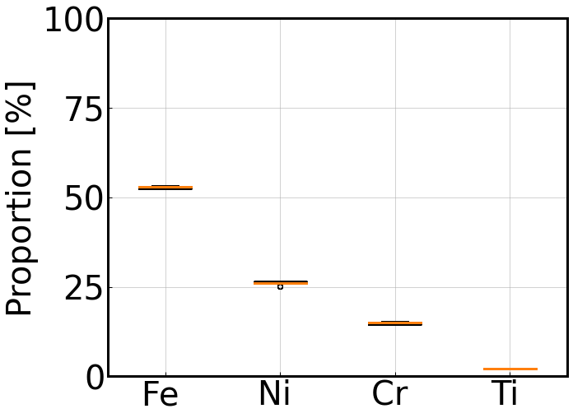
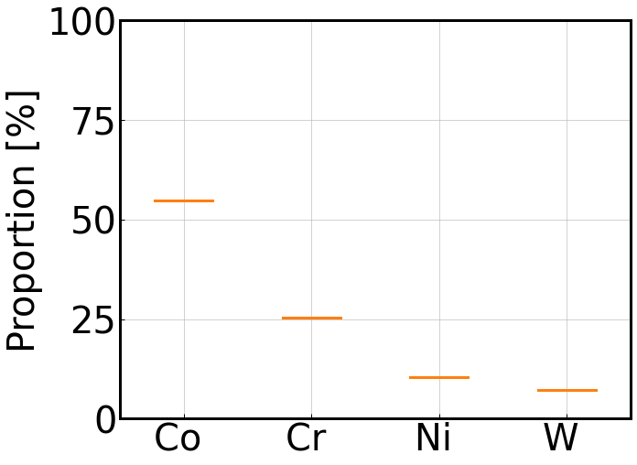
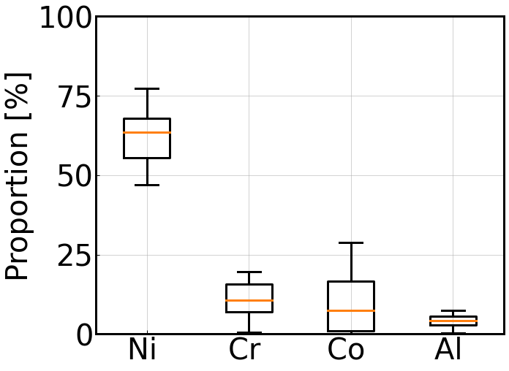
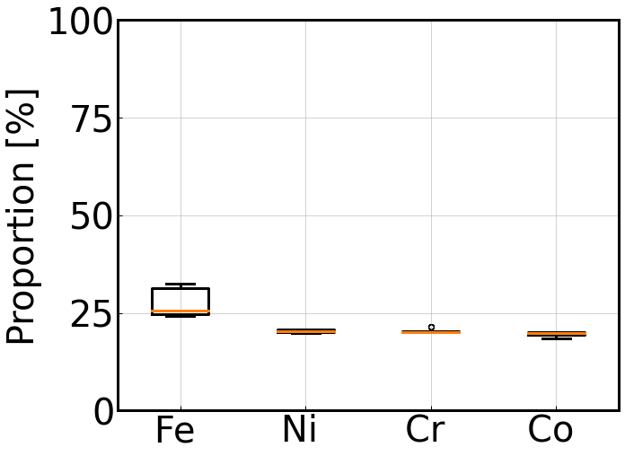
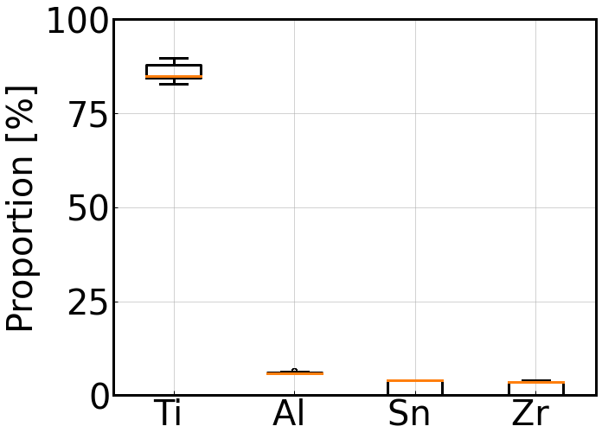
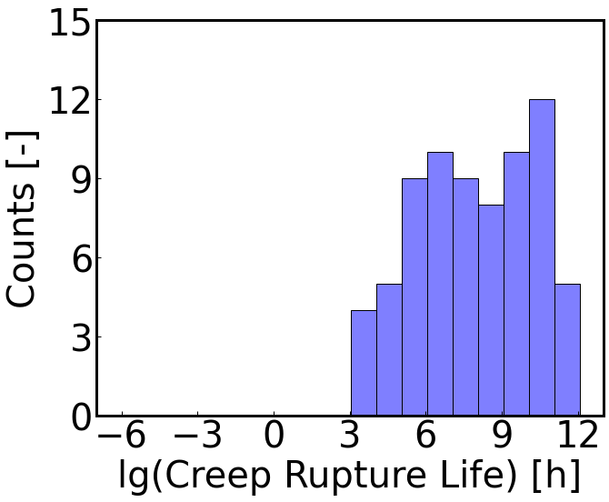
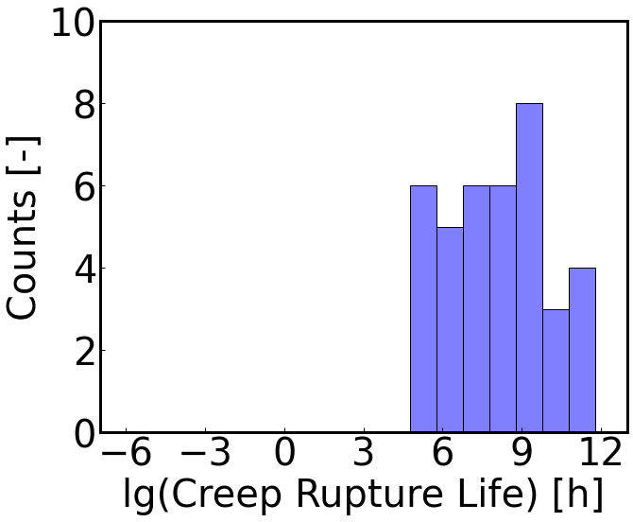
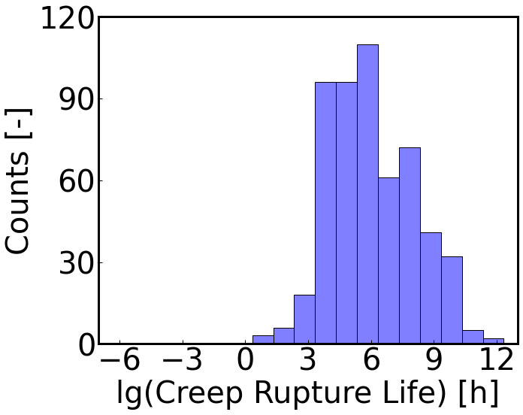
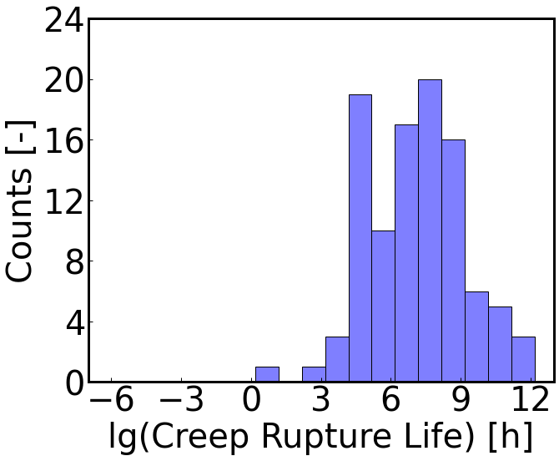
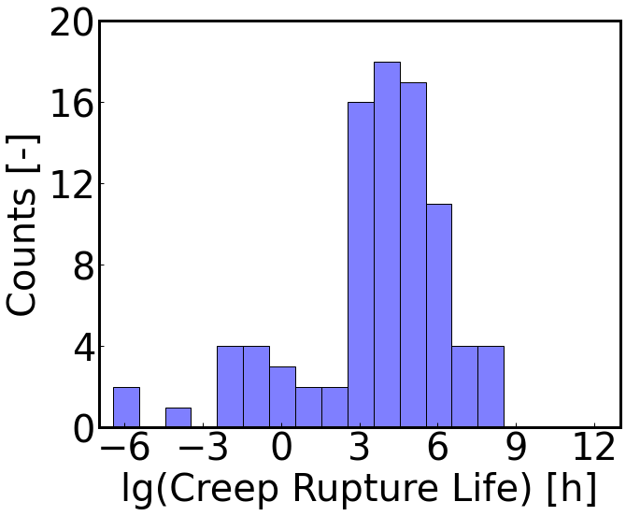
Figure S10
Fe
Co
Ni
Mix
Ti
合金按成分划分

Slide 11
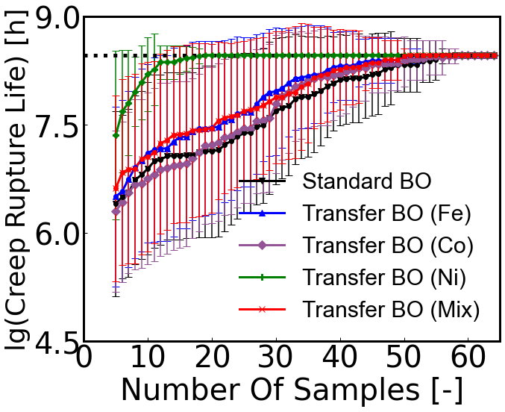
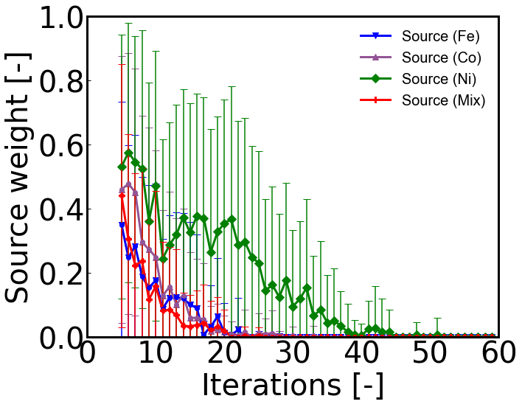
Figure S11
合金按成分划分-迁移

Slide 12
Table S1 ：Palladium-catalyzed cross-coupling reaction dataset
 | Pd catalysts | Bases | Additives
descriptors | ‘NMR-shift’ (C1-C17), 'electrostatic-charge’ (C1-C17), 'NMR-shift’ (H3, H4, H9, H11), 'electrostatic-charge’ (H3, H4, H9, H11), 'electrostatic-charge’ (P1), 'frequency’ (V1-V10), 'intensity’ (V1-V10), 'dipole-moment' | 'electrostatic-charge’ (P1),, 'E-HOMO', 'E-LUMO', 'dipole-moment', 'electronegativity', 'hardness', 'molecular-volume', 'molecular-weight', 'ovality', 'surface-area' | ‘NMR-shift’ (C3-C5), 'electrostatic-charge’ (C3-C5), 'electrostatic-charge’ (N1), , 'electrostatic-charge’ (O1),, 'E-HOMO', 'E-LUMO', 'frequency’ (V1), 'intensity’ (V1), 'dipole-moment', 'electronegativity', 'hardness', 'molecular-volume', 'molecular-weight', 'ovality', 'surface-area'
钯催化描述符

Slide 13
Table S2
 |  | Datasets 1 |  |  |  | Datasets 2
 | Inputs and output | Min | Max | Mean | Standard deviation | Min | Max | Mean | Standard deviation
Inputs | Solution treatment time (h) | 0.5 | 5 | 2.6 | 1.21 | 0 | 2 | 0.8 | 0.93
 | Solution treatment temperature (℃) | 899 | 1348 | 1176.6 | 106.68 | 0 | 1080 | 685.48 | 484.04
 | Solution cooling way | 0 | 4 | 1.38 | 1.37 | 0 | 3 | 0.74 | 0.63
 | Aging treatment time (h) | 1 | 24 | 11.1 | 8.68 | 0 | 50 | 2.77 | 8.44
 | … | … | … | … | … | … | … | … | …
 | … | … | … | … | … | … | … | … | …
 | … | … | … | … | … | … | … | … | …
 | 2nd aging treatment temperature (℃) | 0 | 899 | 507.62 | 401.12 | 0 | 610 | 13.86 | 91.43
 | 2nd aging cooling way | 0 | 1 | 0.26 | 0.44 | 0 | 1 | 0.02 | 0.15
Output | Solution treatment time (h) | 0.5 | 5 | 2.6 | 1.21 | 0 | 2 | 0.8 | 0.93
合金数据集

Slide 14
Table S2
Iterations | 0 | 5 | 10 | 15 | 20 | 25 | 30
Standard BO | 3.46 ± 0.77 | 3.08 ± 1.04 | 2.24 ± 1.0 | 1.79 ± 0.79 | 1.47 ± 0.57 | 1.42 ± 0.54 | 1.35 ± 0.48
Transfer BO 1 | 3.44 ± 0.79 | 2.45 ± 0.53 | 1.83 ± 0.52 | 1.44 ± 0.33 | 1.27 ± 0.13 | 1.24 ± 0.04 | 1.23 ± 0.0
Transfer BO 2 | 3.62 ± 1.08 | 3.33 ± 1.17 | 2.31 ± 1.06 | 1.75 ± 0.92 | 1.58 ± 0.81 | 1.42 ± 0.66 | 1.38 ± 0.61
Transfer BO 3 | 3.31 ± 0.93 | 2.83 ± 1.04 | 2.11 ± 1.05 | 1.58 ± 0.65 | 1.38 ± 0.54 | 1.24 ± 0.02 | 1.23 ± 0.0
二维函数-迁移优化数据表格

Slide 15
Table S3
Iterations | 0 | 10 | 20 | 30 | 40 | 50
Aryl-1
Standard BO | 32.27 ± 4.33 | 38.83 ± 4.94 | 41.77 ± 4.33 | 42.6 ± 3.79 | 43.25 ± 3.37 | 43.78 ± 2.88
Transfer BO 2 | 32.6 ± 4.46 | 40.49 ± 4.99 | 42.82 ± 3.71 | 43.85 ± 2.88 | 44.05 ± 2.67 | 44.65 ± 1.76
Transfer BO 4 | 31.21 ± 5.57 | 38.92 ± 5.29 | 41.88 ± 4.09 | 43.4 ± 3.35 | 44.05 ± 2.67 | 44.38 ± 2.15
Transfer BO 7 | 32.17 ± 4.3 | 37.84 ± 5.66 | 41.84 ± 4.5 | 43.66 ± 3.03 | 44.19 ± 2.6 | 44.4 ± 2.33
Aryl-9
Standard BO | 76.98 ± 6.15 | 82.17 ± 2.74 | 83.23 ± 2.09 | 83.58 ± 2.27 | 84.6 ± 1.5 | 85.18 ± 1.13
Transfer BO 2 | 78.54 ± 6.06 | 83.45 ± 1.29 | 84.29 ± 0.88 | 84.53 ± 0.97 | 84.89 ± 0.92 | 85.26 ± 0.9
Transfer BO 8 | 81.62 ± 5.27 | 85.06 ± 0.76 | 85.45 ± 0.54 | 85.72 ± 0.38 | 85.84 ± 0.22 | 85.87 ± 0.16
Transfer BO 14 | 76.13 ± 5.61 | 83.13 ± 1.52 | 84.98 ± 1.22 | 85.43 ± 0.84 | 85.6 ± 0.73 | 85.72 ± 0.54
Aryl-15
Standard BO | 79.04 ± 13.6 | 92.48 ± 4.4 | 94.39 ± 2.79 | 95.17 ± 2.35 | 95.59 ± 1.85 | 95.97 ± 1.83
Transfer BO 7 | 85.31 ± 7.6 | 92.07 ± 4.59 | 94.18 ± 2.69 | 95.87 ± 1.81 | 96.18 ± 1.83 | 96.38 ± 1.84
Transfer BO 8 | 89.57 ± 9.7 | 94.05 ± 1.81 | 98.06 ± 1.01 | 98.07 ± 1.0 | 98.07 ± 1.0 | 98.07 ± 1.0
Transfer BO 11 | 90.24 ± 8.39 | 94.83 ± 1.16 | 95.45 ± 1.58 | 96.31 ± 1.81 | 96.58 ± 1.82 | 97.12 ± 1.71
钯催化-迁移优化数据表格

Slide 16
Table S4
Iterations | 0 | 5 | 10 | 15 | 20 | 25 | 30
Optimization task 1
Random | 10.71 ± 0.78 | 11.22 ± 0.55 | 11.55 ± 0.43 | 11.71 ± 0.29 | 11.73 ± 0.26 | 11.79 ± 0.19 | 11.82 ± 0.18
Standard BO | 10.96 ± 0.67 | 11.51 ± 0.39 | 11.76 ± 0.29 | 11.84 ± 0.11 | 11.84 ± 0.11 | 11.88 ± 0.09 | 11.89 ± 0.08
Transfer BO | 10.57 ± 0.92 | 11.55 ± 0.38 | 11.76 ± 0.27 | 11.8 ± 0.24 | 11.87 ± 0.11 | 11.9 ± 0.06 | 11.91 ± 0.04
Optimization task 2
Random | 6.29 ± 1.09 | 7.3 ± 0.98 | 7.97 ± 0.64 | 8.15 ± 0.5 | 8.27 ± 0.45 | 8.27 ± 0.45 | 8.44 ± 0.14
Standard BO | 5.96 ± 1.23 | 7.26 ± 1.15 | 8.04 ± 0.86 | 8.23 ± 0.68 | 8.38 ± 0.39 | 8.45 ± 0.1 | 8.47 ± 0.0
Transfer BO | 6.09 ± 1.02 | 7.55 ± 1.19 | 8.26 ± 0.57 | 8.4 ± 0.33 | 8.47 ± 0.0 | 8.47 ± 0.0 | 8.47 ± 0.0
合金-迁移优化数据表格

Slide 17

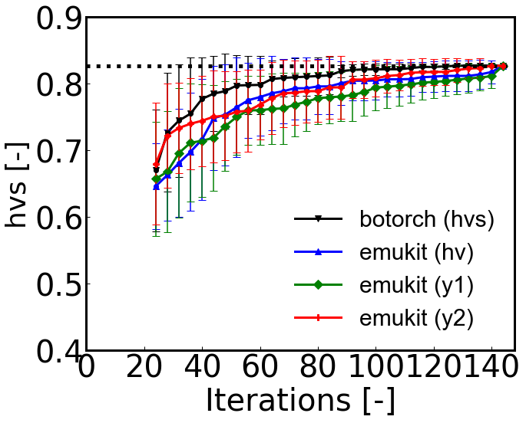
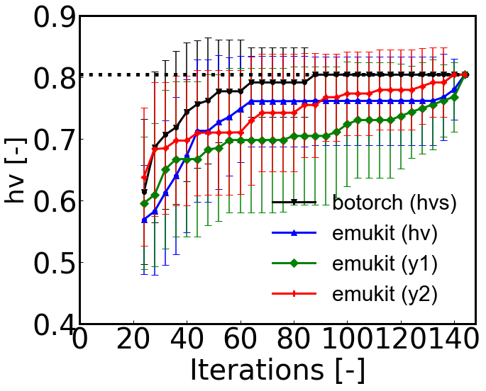
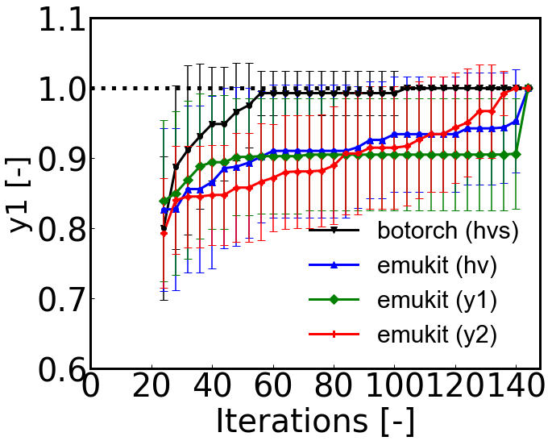
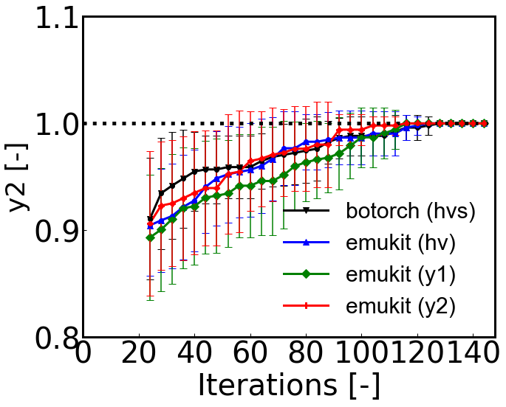
多目标BO
多目标BO同时提升两个目标变量

